Slide 1
Capstone Project
Data – western Countries Financial Data
Name – Gaurav ram singh
Course – Business Analytics
Platform – Skill academy
Batch – 8

Slide 2
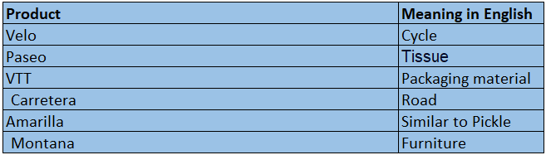
Introduction to DATA
5 Countries & segments
During 2013 and 2014
Sales, profit, COGS, Units Sold, Manufacturing cost, Discounts…..
Understanding;

Slide 3
Findings Velo in Mexico
Negative growth of 5 percent
least profitable
Investigation is must
1st half of year low sales
2nd half of year high sales, suggesting a seasonal pattern.
Cost management during loss

Slide 4
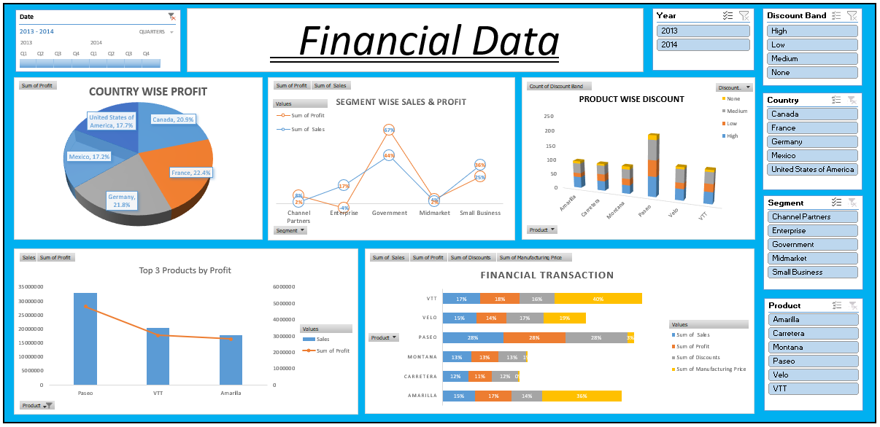
Excel dashboard

Slide 5
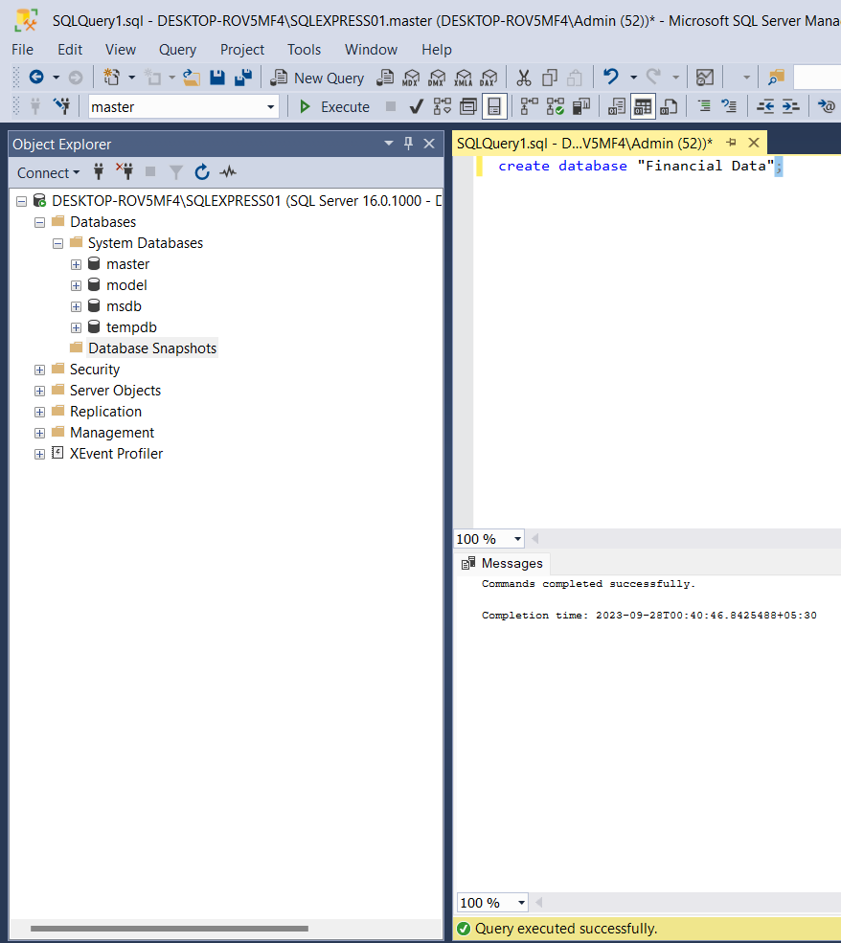
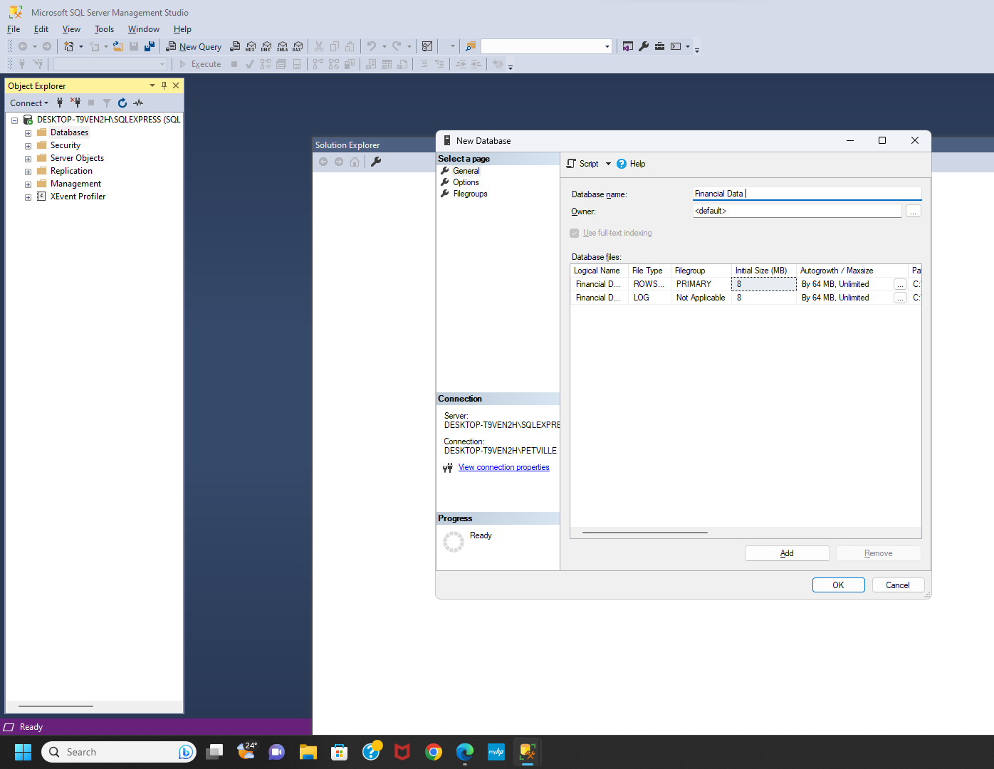
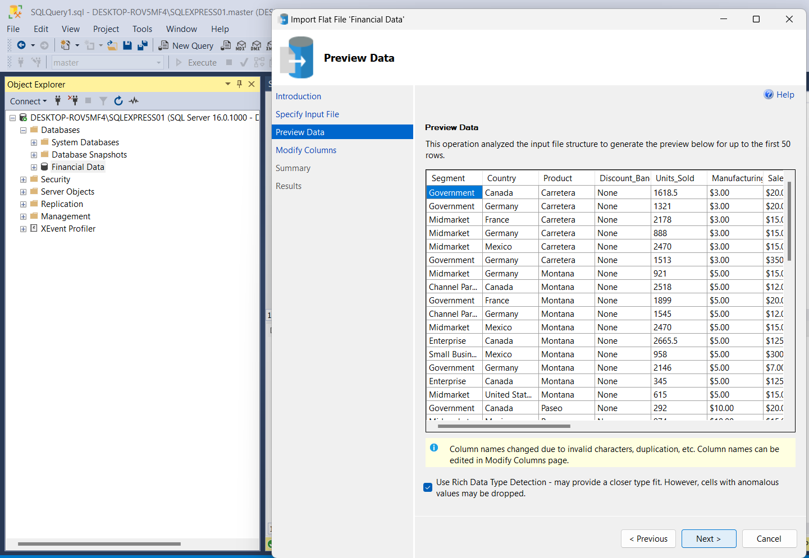
databaSE in SQl
Importing CSV file
Naming
Creation

Slide 6
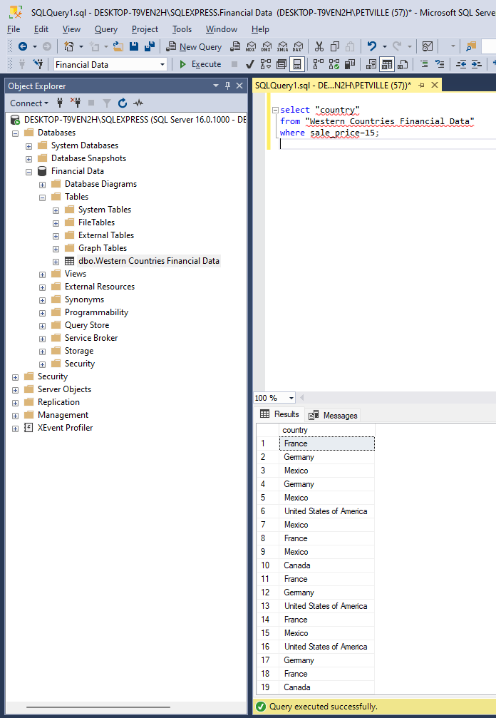
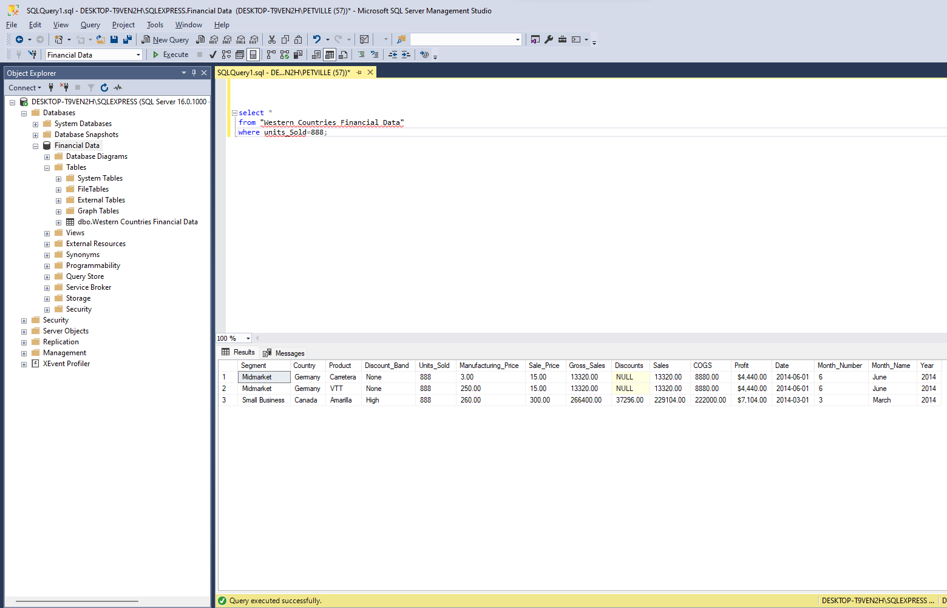
Testing dataset with queries
select "country"
from "Western Countries Financial Data"
where sale_price=15;
select *
from "Western Countries Financial Data"
where units_Sold=888;

Slide 7
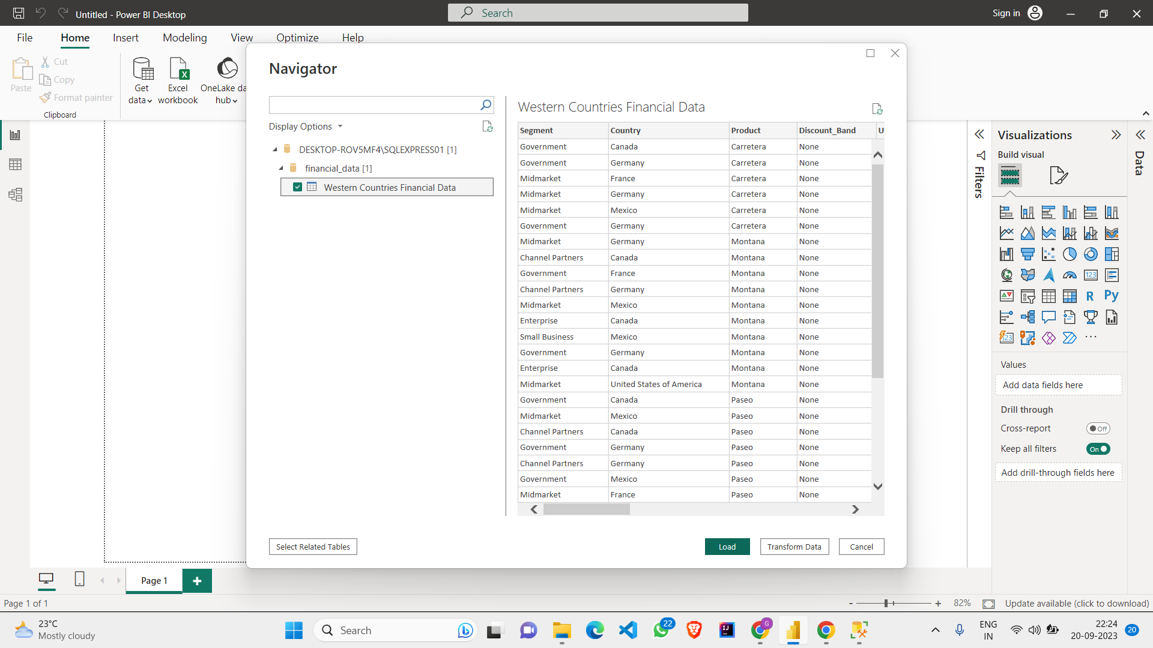
Importing data in PowerBI from SQL

Slide 8
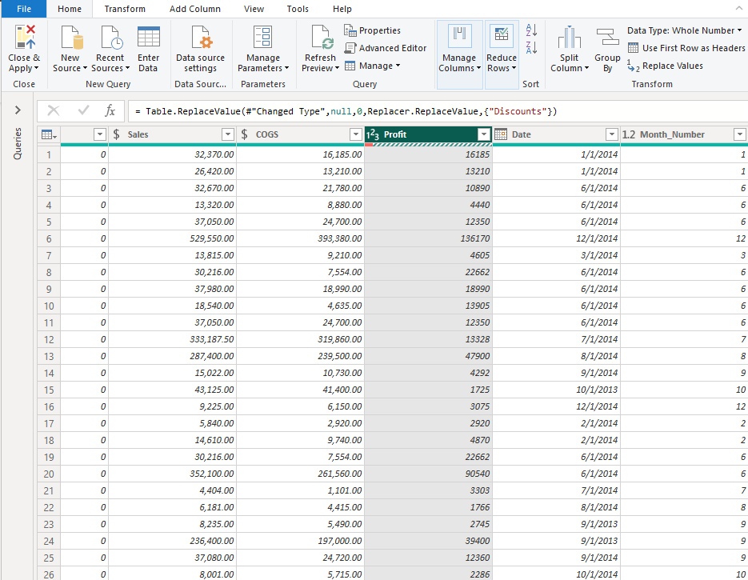
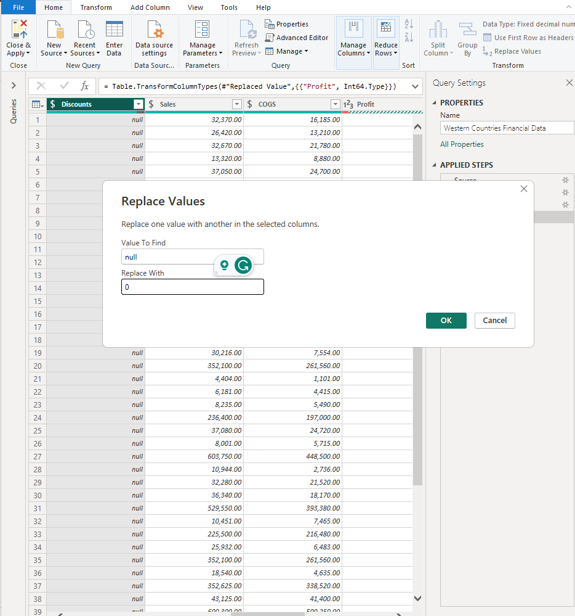
Data cleaning
Profit- text to whole no
- $ replaced by _
Column ‘Discount’ null replaced by 0

Slide 9
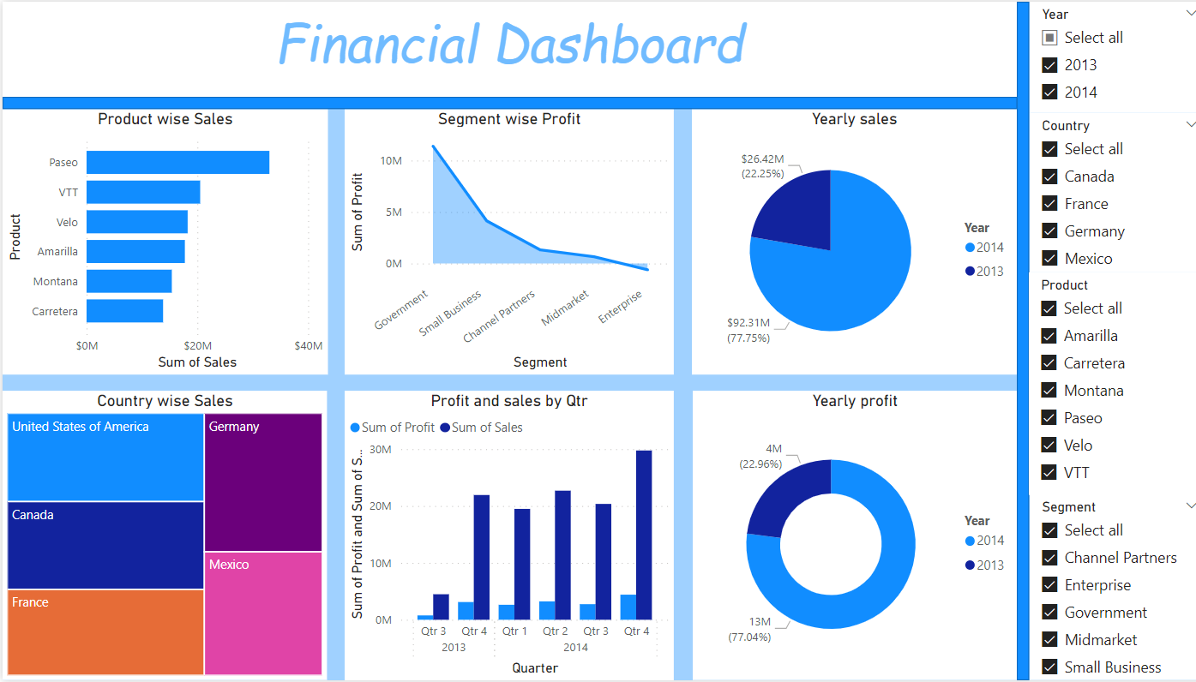
Powerbi dashboard

Slide 10
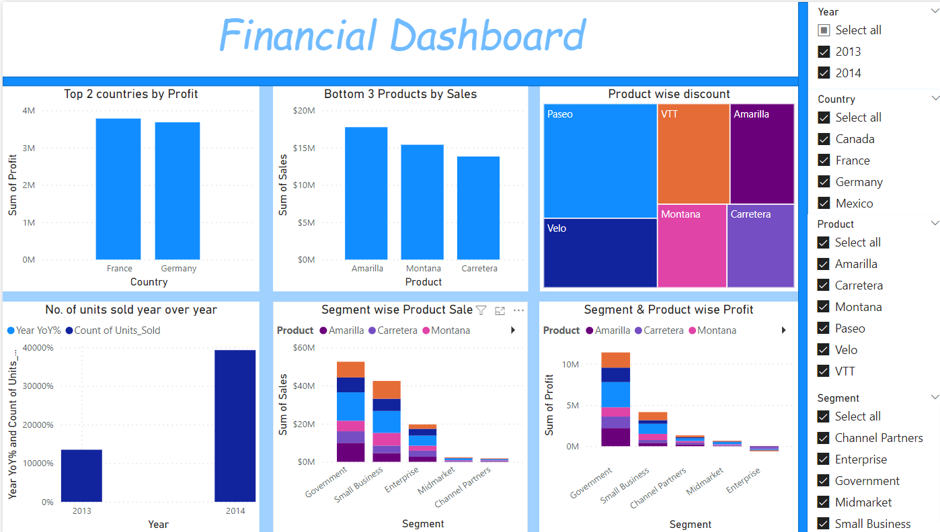
Power bi dashboard

Slide 11
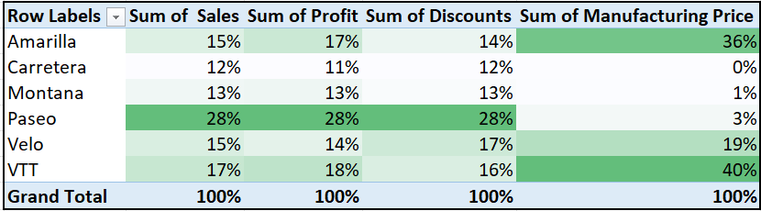
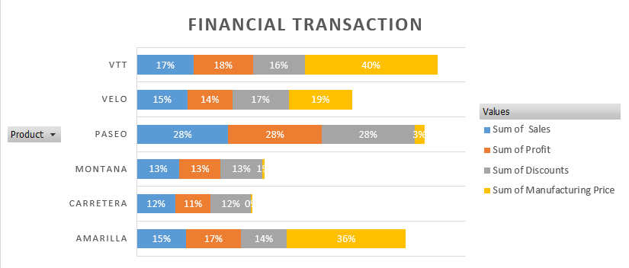
Practical Inference
Low manufacturing costs & expenses
High scope for margin
Running offers & discounts
High sales
High profit

Slide 12
Conclusion
Pro
The Min & Max country-profit contribution was 14% to 28% in 2013; which ended up being 18% & 23%; the reduction in range from 14% to 5% indicating an increase in consistency.
The government segment alone contributes to 44% of overall profit, of which 46% comes from France & and Germany whereas the USA contributes to only 15%. Which indicates government sector has a great grip.
The drastic YOY improvement ratio of sales contribution in 2013 & 2014 is 2:7; which is commendable growth.
Con
The Enterprise segment has increased its loss from 1.9 to 4.2 lakh from the year 2013 to 2014; further growth in loss is expected if no actions are taken.
The enterprise segment suffered a drastic loss of 194k in 2013 which rose to 421 by 2014 on the contrary it has shown the highest growth in sales & profit; 8 & 13% respectively. So must strategically decide if it can improve further or needs to discontinue.
The product Carretera is the lowest contributor to sales & and profit; <12% and <1% to profit so improve or discontinue.

Slide 13
thanking you
Hope to have
Added to your
understanding!

